Slide 1
Security
Team or presenters name
Date: 26/05/2020
Location: DUB

Slide 2




Virtual Housekeeping
Use
Headsets
Go on
Mute
Participate Actively
Minimize Distractions
Notes:
***Please ensure you have your headset plugged in so we can avoid echoing and maintain audio quality
***Throughout the session, please keep your mic on mute to avoid background noise during the presentation portions.
***Please be aware you will be asked to participate and engage throughout the session. We ask that you are fully active in the chat box, and are also ready to be called on and unmute if needed. We’ll also have you click on some links to view videos, participate in polls and at some point during the session, we’ll be sending you to specific break out rooms depending on which service you’ll be shadowing.
***Lastly, we ask that you’re fully present. Keeping engaged is even more difficult in a virtual setting, so make sure you turn off notifications, maybe set an out of office in your email. Minimize distractions

Slide 3
Course objectives
special permissions
SELinux
miscellaneous
Notes:
Special permissions go beyond the basic rwx.
We will explore different options and use cases
SELinux is security enhanced linux and is a very powerful security mechanism
Miscellaneous are a mixture of different topics and tips to enhance linux security in general

Slide 4
special permissions
special bits
file attributes
ACL (access control lists)
Notes:
Does anybody know any file permissions in Linux besides the basic rwx ones you already learned about?
There are three more which are interesting to know for troubleshooting but mostly from a security point of view
The first one are special bits or sometimes called modes. There are three of them. setuid bit, setgid bit, and sticky bit
They do change the behaviour depending on which bit is set and if it’s a file or folder
The second one are extended file attributes, which for example can make files immutable. (Make sure audience knows what that means)
The last one and most extensive ones are ACLs or access control lists, which lets you control access to files beyond the constraints of the three groups in the traditional permissions (user,group,other)

Slide 5
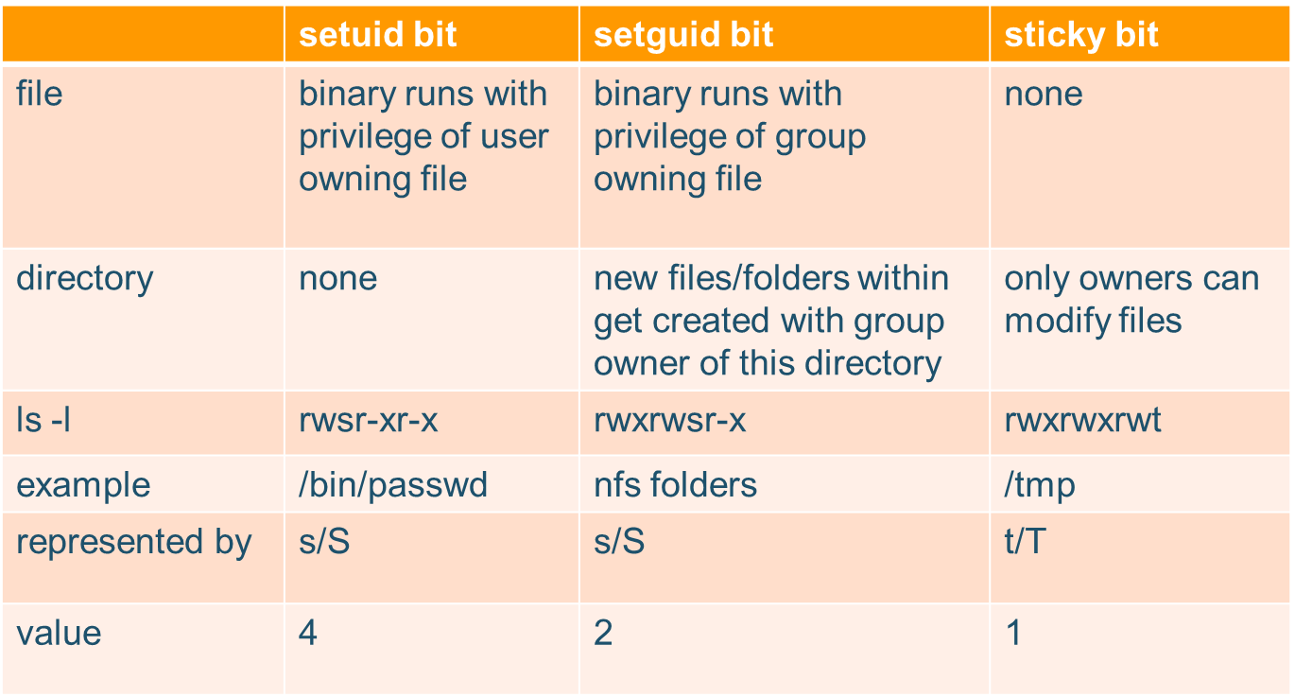
setuid bit, setgid bit, and sticky bit
Notes:
While there are three of these special bits, they do have different effect when they are used on files or directories.
Let’s first have a look at what they do, how we can identify them and then afterwards how to change them if needed.
(go through the table)
setuid and setguid bits are represented by an s where you normally see the x in the default permissions.
If the x is not present, the S will be capital (which rarely happens)
For the sticky bit the t/T is used. (I have not seen a good explanation for this yet myself)
Let’s now have a look at how to set them

Slide 6
set special bits
setuid:
chmod 4775 test
chmod u+s test
setguid:
chmod 2775 test
chmod g+s test
sticky bit:
chmod 1775 test
chmod o+t test
set them all: (does not make practical sense)
chmod 7775 test
Notes:
They can be assigned in numeric format just like the default permissions or via adding them with + and –.
Like seen in the previous slide, setuid represents the value 4, setguid 2 and the sticky bit 1.
With this information, we can set them in the numeric format. They use a hidden fourth value which is put in front of the three regular ones (underlined)
We can also set them using u+s,g+s and o+t and we can remove them in the same way as well
When do I want to use them?
In some ways the operating system already uses them as seen with the passwd command or the /tmp folder.
Frequent (mostly older) use cases are using the setguid bit for shared folders in NFS or for a web server folder, so that the group is apache for all documents and readable by apache itself.
You will rarely see these special bits playing a role in troubleshooting.
From a security point of view be aware that they can actually present a risk, if someone is able to edit a file that then later gets executed by the root user for example. So use these with caution but be aware of them.
The special bits are sometimes used to workaround implementing proper security measures and guidelines.

Slide 7
file attributes
There are 15 of them, but the ones mostly used are:
a – append only
i – immutable
lsattr and chattr to list and change these attributes
Notes:
File attributes are extended flags you can set to a file in order to change it’s behaviour.
Please note that the kernel and the file system needs to have support for these.
There are a lot of them, but most of them are unused or not widely supported.
The only two that you will sometimes encounter are :
a – append only
i - immutable
You can use the two commands lsattr and chattr to list and change these attributes or flag.
Let’s have a look at an example

Slide 8
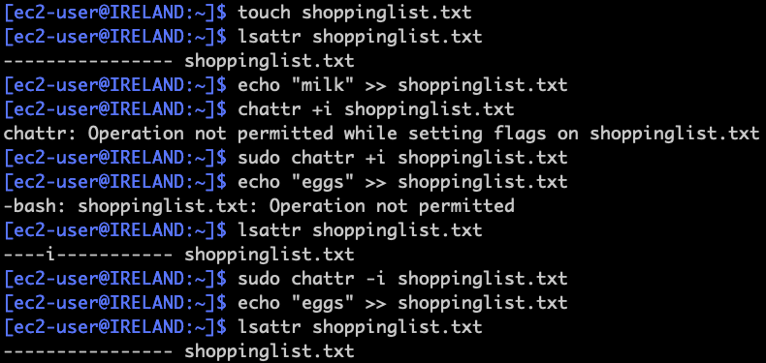
file attribute example
Notes:
What was done here:
create file shoppinglist.txt
list attributes (none set)
add milk to shoppinglist.txt
change attribute to immutable (without sudo failed)
change attribute to immutable with sudo
add eggs to shoppinglist.txt (failed)
list attributes of shoppinglist.txt
change attribute back to mutable
add eggs to shoppinglist.txt (success)
list attributes one more
You can use this for example to make sure that a file does not get changed accidentially.
Again, this is often used as a quick and dirty workaround for config files.
There is usually a better way of handling this, put it does present an option.

Slide 9
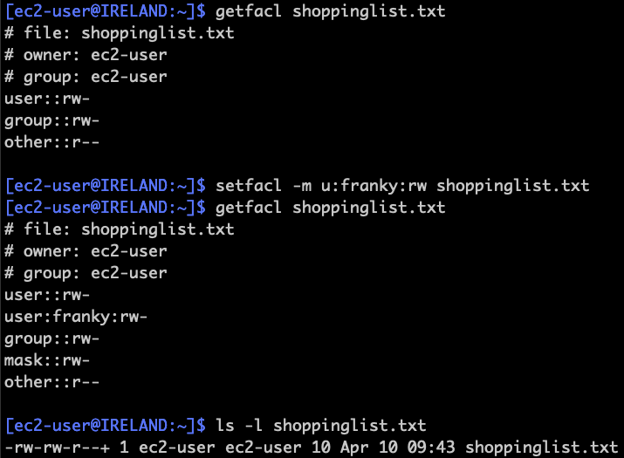
ACL (access control lists)
setfacl -m
"u:user:permissions” <file>
getfacl <file>
Notes:
ACL can be used to set finer grained permissions to files in Linux.
Again, the kernel and the file system actually needs to support them, which most of them these days do by default.
So for example, going back to the shopping list, let’s say I want to give a user called franky access to write to this file, without adding him to the group of the file. Otherwise he could edit other files that are owned by my group as well.
So let’s have a look at how to achieve this.
We in general have two command, similar in usage to the file attributes, which are getfacl and setfacl
In this example the following happened
showing ACLs of file shoppinglist (none set)
setting user franky to have rw permissions on file shoppinglist.txt
ls –l shows a little + after the basic permissions indicating ACLs are in use
Let’s have a look at a practical example you are more likely to encounter when troubleshooting

Slide 10
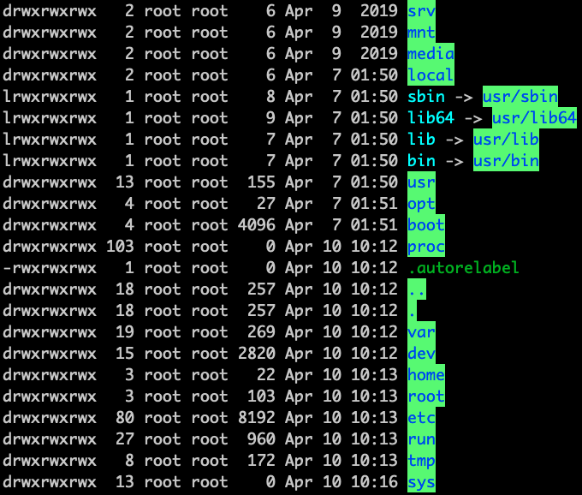

ACL example
chmod –R 777 /
getfacl -R / >permissions.facl
setfacl --restore=permissions.facl
Notes:
Let’s suppose a user did overwrite the file permissions of the entire operating system instead of just a directory or file by mistyping a command
This leaves us with multiple problems, the first one usually being that you can’t login via ssh.
You also don’t know which are the default file permissions for every file.
Users that do these things are less likely to have a recent backup than the average one for some reason.
Luckily, getfacl gives us the option to save all standard and ACL permissions in a file.
We can execute this on a similar system (or AMI) and then use setfacl to restore the permissions.

Slide 11
SELinux
Stands for Security Enhanced Linux
What is it?
TLDR – A linux kernel module
Why use it?
DAC/ MAC
Discretionary Access Control
Users, groups and processes
UID, GID, SUID.
So for access control we have:
Rwxrwxrwx
Notes:
SELinux is security enhanced Linux.
- It is a linux kernel security module which provides mechanisms for supporting access control security policies
why do we use it (or why most people don’t use it)
All processes and files are labeled. SELinux policy rules define how processes interact with files, as well as how processes interact with each other. Access is only allowed if an SELinux policy rule exists that specifically allows it.
Fine-grained access control. Stepping beyond traditional UNIX permissions that are controlled at user discretion and based on Linux user and group IDs, SELinux access decisions are based on all available information, such as an SELinux user, role, type, and, optionally, a security level.
SELinux policy is administratively-defined and enforced system-wide.
Improved mitigation for privilege escalation attacks. Processes run in domains, and are therefore separated from each other. SELinux policy rules define how processes access files and other processes. If a process is compromised, the attacker only has access to the normal functions of that process, and to files the process has been configured to have access to. For example, if the Apache HTTP Server is compromised, an attacker cannot use that process to read files in user home directories, unless a specific SELinux policy rule was added or configured to allow such access.
SELinux can be used to enforce data confidentiality and integrity, as well as protecting processes from untrusted inputs.
Main differences:
DAC and MAC
Discretionary Access Control is the access control mechanism used by Linux.
It is a mechanism for delegating permissions to a groups(even groups of one) of user’s based on attributes related to their user identity.
Within Linux’s DAC, we can assign Read Write and Execute permissions, on a per user, group and world basis. This allows ease of management as we do not have to set up individual permissions for each user on each file. This can be managed by group membership etc.
These are the basic file permissions you have already learned about in previous modules

Slide 12
MAC
Mandatory Access Control
Subject – user, process, appliaction
Objects – files, devices, etc
SELinux security server
- Policy enforcement server
SELinux Policy Database
Access Vector Cache
Notes:
SELINUX defines the access and transition rights for every user, process and file on the system.
It the governs the interactions between these entities using a security policy which specifies how strict/lenient the operating system should be.
Subjects – user process, application
Objects – files, devices etc
SELinux security server – process that runs in the kernel, in kernel space
- policy enforcement server
SELinux Policy Database- stored rukes about policies
AVC, access vector cache, caches data about subject-object permissions.,

Slide 13
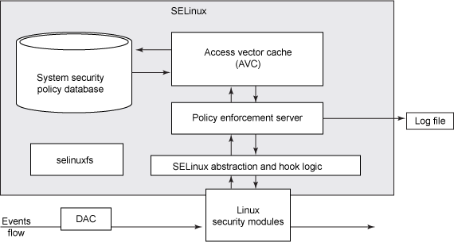
workflow
Notes:
Action Request comes from a process and hits the SELinux Secuirty Server, permissions are checked against the rules in the policy database, if permission is granted, the action on the object is permitted, if not you see an AVC denied message in /var/log/messages
We can see here that DAC (basic permissions) are evaluated before SELinux MAC.

Slide 14
Modes
Enforcing mode
Enforces rules and logs to /var/log/messages
Permissive mode
Does not enforce rules, but still logs messages and denies based on policy rules database and AVC.
Disabled mode
/etc/sysconfig/selinux
Notes:
Enforcing mode- This mode is self explanatory, it uses the rules specified in the policy database. It logs any output messages to /var/log/messages so that you can review what has been attempted/denied by users on the system.
Permissive mode- This mode is more used for discreet monitoring and investigation. It evaluates the rules which you have specified in the policy database, but does not enforce them. This means that you can track/log what priviledged actions a user is performing without them knowing.
Disabled mode disables SELinux completely
Disabled is the default setting for amazon linux 2 , enforcing for Red Hat 8
There is no real consent on the default and whether SeLinux is a blessing or a curse
/etc/sysconfig/selinux -> softlinked to /etc/selinux/config
Enforcing – policy is enforced
Permissive – policy is not enforced but is checked and logged.
disabled- SELinux is fully disabled. Hooks are disengaged from the kernel and the pseudo-filesystem is unregistered
Targeted -> Only specific network daemons are protected.
Strict-> All daemons are tracked.

Slide 15
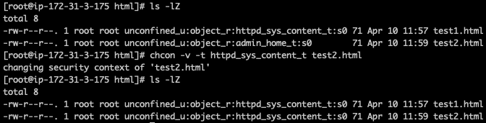
example
Notes:
web server example for illustration
On systems running SELinux, all processes and files are labeled in a way that represents security-relevant information. This information is called the SELinux context. For files, this is viewed using the ls -Z command
In this example, SELinux provides a user (unconfined_u), a role (object_r), a type (admin_home_t), and a level (s0). This information is used to make access control decisions. On DAC systems, access is controlled based on Linux user and group IDs. SELinux policy rules are checked after DAC rules. SELinux policy rules are not used if DAC rules deny access first.
We can see test1 has the type httpd_sys_content_t, which is needed to have the web server being able to read the file
Since admin_home_t is not the expected type in the web server directory /var/www/html users will get a 403 (permission denied) when accessing this web page
to change the security context, the command chcon can be used.
In this example the command changes the security context from admin_home to httpd_sys_content_t.
After this change the web server is able to display the page to visitors.
Further information on SeLinux can be found here:
https://access.redhat.com/documentation/en-us/red_hat_enterprise_linux/8/html-single/using_selinux/index

Slide 16
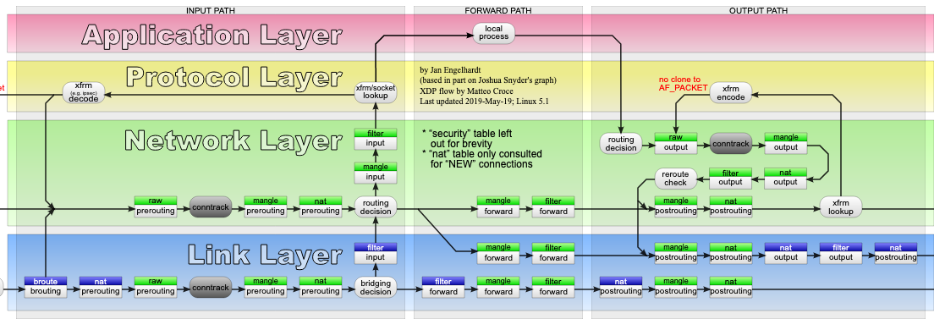
iptables
Notes:
Iptables is used to set up, maintain, and inspect the tables of IP packet filter rules in the Linux kernel.
This was or will get covered in the network sessions.
This is why we only mention it here, since it is from a network perspective a much used and very powerful and versatile tool
This is the complete workflow for illustration

Slide 17
Miscellaneous
Open ports : netstat –tunap
TCPWrappers : /etc/hosts.deny $ /etc/hosts.allow
Access restriction: /etc/security/access.conf
Special Mount options: noexec,nosuid
Logging and Auditing
Keep system updated
Notes:
Before implementing firewall rules, always check which processes are actually running and listening.
If you don’t need them, stop them
use netstat with some options to see the ports being listened on
You can then use systemctl to stop unneeded services
Keep the system up to date where possible
You can test it first on a test system and then automatically enable updates either via crontab or SSM patch manager (AWS)
Only give people access that need it
Avoid root access via ssh, use pem files instead of passwords

Slide 18
Restrict ssh access Things to look out for in /etc/ssh/sshd_config: AllowUsers, DenyUsers, AllowGroups, DenyGroups HostKey ListenAddress PasswordAuthentication,PermitEmptyPasswords MaxAuthTries PermitRootLogin

Slide 19
limits
/proc/sys/fs/file-max
/etc/security/limits.conf
Notes:
You can put limits into place to aid the security of the system, like how many concurrent processes are allowed or how many files a user can open.
To limit the maximum number of open files systemwide, you can use sysctl. The current value is stored in /proc/sys/fs/file-max
User specific limits are in /etc/security/limits.conf
Malicious software might try to open a large number of files at once or start a huge amount of processes.

Slide 20
You should now be familiar with…
special permissions
SELinux
miscellaneous
Notes:
Where to go from here?
I encourage you to work on a backup script yourself and to try to automate other system administration tasks
All the scripts shown here are also in the comment of the slides available.
The examples here are by no means perfect but should give you a good starting point in scripting and ideas to come back to if needed.
Try to make the script run every day automatically, include multiple folders, give more verbose information about the files and folders and size of them backed up.
You can create a backup logfile which you then automatically uploads to cloud watch logs, which you can then analyze and connect to an SNS topic.
More on AWS services in the coming weeks
In general, if you’re having issues with your script, you can include ”set –x” at the start of the script after the shebang.
I adds verbosity and basically prints the tracing of the commands inside the script. Set is a bash builtin function like echo.
Scripts are also often used here in AWS for the AWS CLI or the AWS SDK.
(if not done already, the log labs can be used now in slide 8 and 12)

Slide 21
exercise
observe examples of special bits (/etc/passwd, /tmp)
2a) create folder with SETGUID bit and create a file in it
2b) move an existing file into the folder and observe the difference
3) make a file immutable
4) save ACLs of a folder, change them and then restore it
5) display your SELinux mode, enable enforcing mode
6) create test html file in apache root folder and check the SELinux attributes
7a) Display all open ports on the system and their processes
7b) Stop any unneeded services
8) Secure /tmp by making non-executable

Slide 22
Insist on the highest standards
Please take 2 minutes to complete the survey to let us know what you liked about the training and what can be improved.
This will help us to continue creating helpful and relevant training content.
Link is in the invitation email.

